Slide 1

ECEN 461
Real-Time and Embedded Systems
IOT - Information - Sampling
Notes:
&&& Need to add more to this lecture – not enough meat

Slide 2
Agenda
Prayer/Thought
Sampling
Aliasing
Spectral View of Sampling
Spectral View of Aliasing

Slide 3
Sampling x(t)
What is sampling?
Sampling Process
Convert x(t) to numbers x[n]
“n” is an integer; x[n] is a sequence of values
Think of “n” as the storage address in memory
Uniform Sampling at t = nT_{s}
ideal: x[n] = x(nT_{s})
x(t)
A-to-D
x[n]

Slide 4
Sampling Rate, f_{s}
Sampling Rate (f_{s})?
f_{s} =1/T_{s}
Number of Samples per Second
T_{s} = 125 microsec → f_{s} =
Units are Hertz: 8000 Hz
Uniform Sampling at t = nT_{s} = n/f_{s}
ideal: x[n] = x(nT_{s})=x(n/f_{s})
8000 samples/sec
x[n]=x(nT_{s})
x(t)
A-to-D

Slide 5
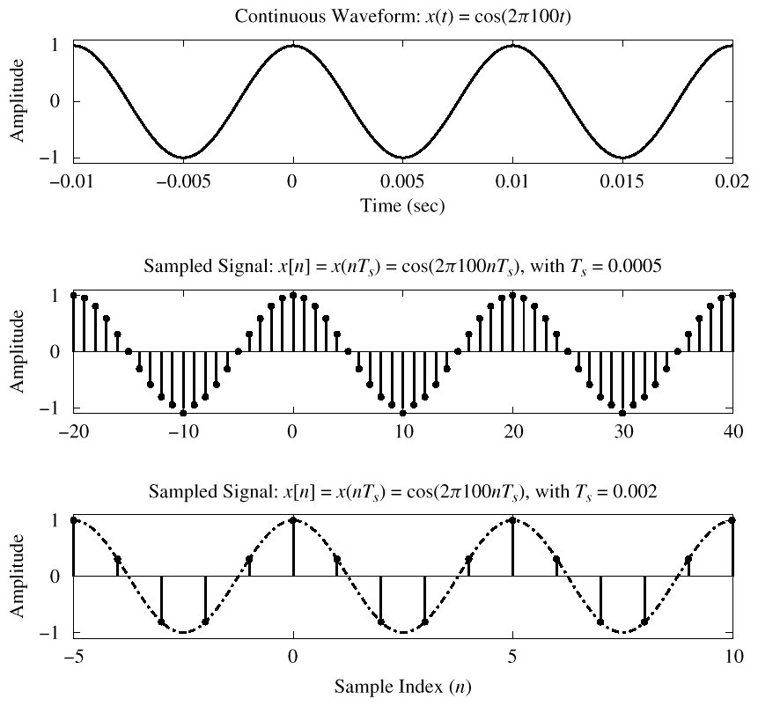
Sampling Example
How many samples/period do we get?
f_{s}/f = samp/period
20 samp/period
5 samp/period

Slide 6
Discrete-Time Sinusoid
Change x(t) into x[n]
Digital Frequency

Slide 7
Digital Frequency
varies from 0 to 2π, as f varies from 0 to the sampling frequency
Units are radians, not rad/sec
Digital Frequency is Normalized

Slide 8
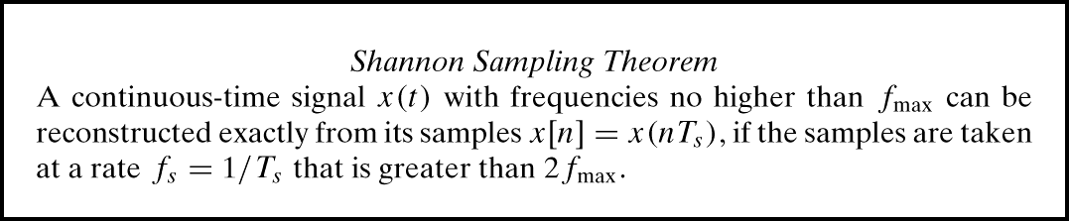
Sampling Theorem
So, how often should we sample?
Depends on the frequency of the signal
Answered by Shannon/Nyquist Theorem
Also depends on reconstruction needs

Slide 9
Digital Sound
x(t) is a Black Eye Pea song (or Mormon Tabernacle Choir ☺)
How fast should we sample it?
Audio CD
CD rate is 44,100 samples per second
16-bits/sample
Stereo - uses 2 channels
Number of bytes for 1 minute of the song?
2 * (16/8) * 60 * 44100 = 10.584 Mbytes
What happens if we don’t sample at ≥ 2f_{max}?

Slide 10
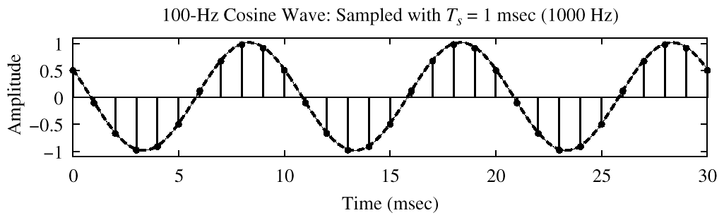
Spectrum of a Digital Signal
What does this mean?
–0.2π
2π(0.1)

Slide 11
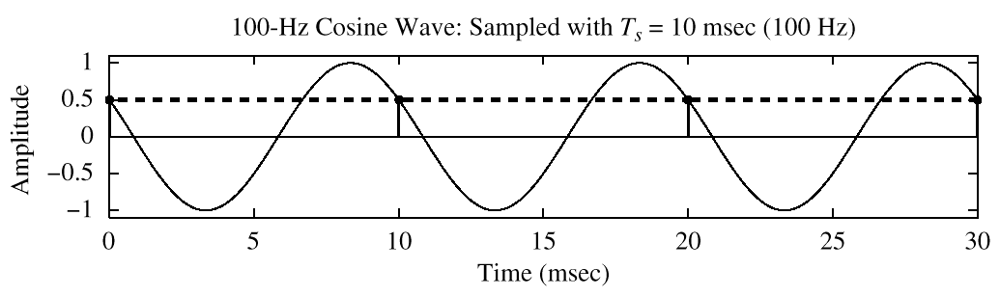
Another Digital Spectrum What does this mean?
?
–2π
2π(1)
x[n] is zero frequency???

Slide 12
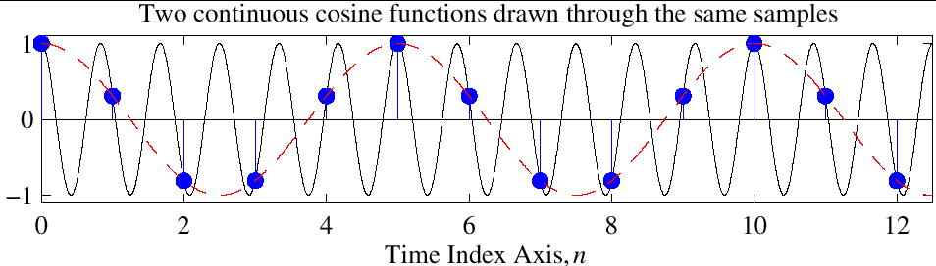
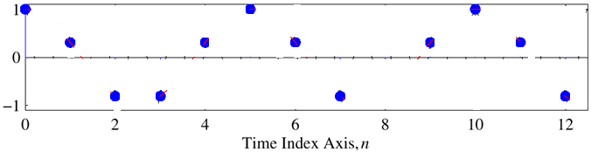
Reconstruction?
Given the samples, draw a sinusoid through the values

Slide 13
Periodic Spectrum
Spectrum of x[n] has more than one line for each sinusoid
Called Aliasing
Spectrum is periodic with period = 2π
Because

Slide 14
Aliasing Derivation
Other Frequencies give the same

Slide 15
Aliasing Summary
Adding f_{s} or 2f_{s} or –f_{s} to the Freq of x(t) gives exactly the same x[n]
The samples, x[n] = x(n/ f_{s} ) are exactly the same value
Given x[n], we can’t distinguish f_{o} from (f_{o} + f_{s} ) or (f_{o} + 2f_{s} )
Normalized Radian Frequency

Slide 16
Spectrum for x[n]
Plot versus Normalized Frequency
Include all Spectrum Lines
Aliases
Add Multiples of 2π
Subtract Multiples of 2π
Folded Aliases
(to be discussed later)
Aliases of Negative Frequencies

Slide 17
Spectrum (More Lines)
–1.8π
–0.2π
2π(0.1)
1.8π

Slide 18
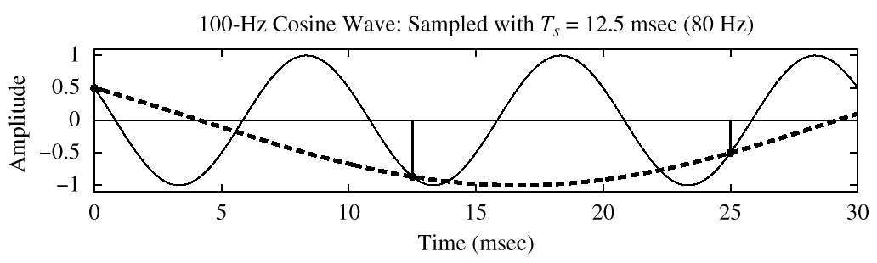
Spectrum (Aliasing Case)
–2.5π
–1.5π
–0.5π
0.5π
1.5π
2.5π

Slide 19
con2dis Demo

Slide 20
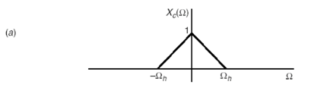
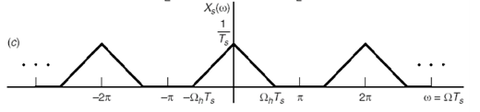
More complex spectrum
Frequency spectra of a continuous time signal
Frequency spectra of this continuous time signal sampled at fs > 2fmax

Slide 21
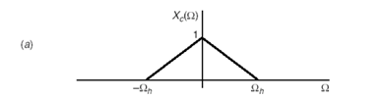
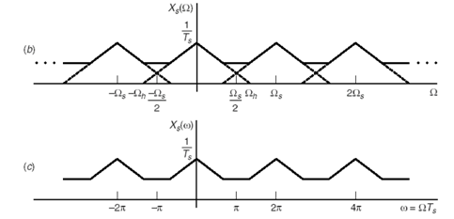
More complex spectrum
Frequency spectra of a continuous time signal
Frequency spectra of this continuous time signal sampled at fs < 2fmax

Slide 22
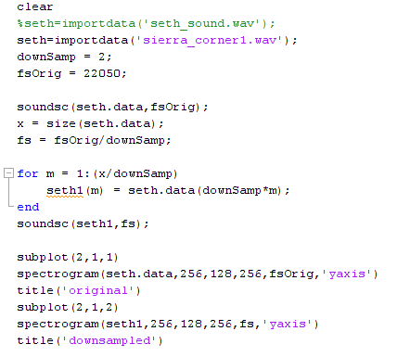
Demo songs showing effects of sampling and aliasing
Frequency spectra of a continuous time signal
Frequency spectra of this continuous time signal sampled at fs > 2fmax
Frequency spectra of this continuous time signal sampled at fs < 2fmax

Slide 23
Lab 3
Create some musical instruments

Slide 24
Backup

Slide 25
Demo songs showing effects of sampling and aliasing
Seth_sound
&&& need to add math for sampling seth_sound in different sample freq’s
Show how the frequency of the sound increases/decreases as we change sampling rates

